Slide 1





Coffee
Reg $4.70
Lge $5.70
Reg $5.90
Cappuccino, Flat White, Latte, Long Black | Iced Long Black | Lrg | $6.90
Mocha, Chai Latte, Hot Chocolate, Dirty Chai | Iced Latte | Lrg | $6.90
Reg $5.90
Tea Reg $4.00 English Breakfast, Earl Grey, Peppermint, Jasmine Green
Lge $4.50
Iced Coffee Frappe
Milkshakes Reg
$8.90
$6.90 Lrg
$7.90
Chocolate, Strawberry, Caramel or Vanilla
Espresso Babyccino
Extras Each
Extra Shot,
Reg $4.00 Reg $2.00
$1.00
Soy, Almond, Oat or Lactose Free Milk Decaf
Flavoured Shots $1.00
Caramel, Hazelnut, Vanilla

Slide 2



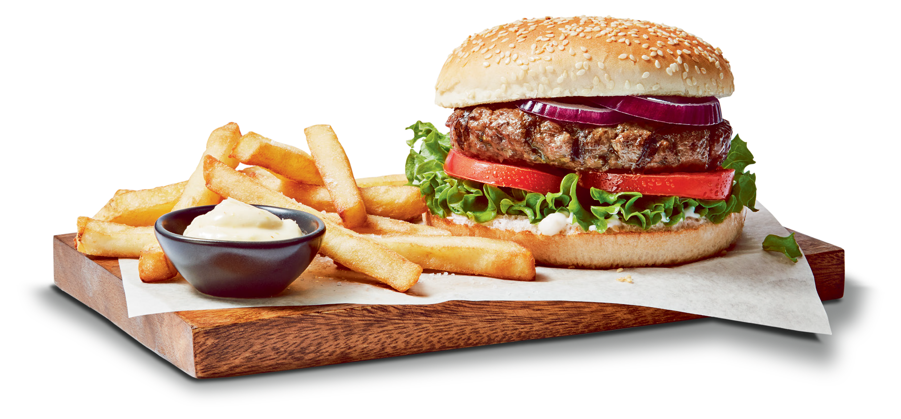
Any Burger with Chips
BURGERS
Beef Burger*
With Signature Burger Sauce
(GFO) Bacon + $3.50
Chicken Schnitzel Burger
With Fresh herb mayo. Bacon + $3.50
Steak Sandwich*
With Scotch fillet, Tasty Cheese, BBQ Sauce
(GFO) Bacon + $3.50
Grilled Halloumi Burger*
(11am to 2pm)
$16.95
$20.95 With Chips
& 600mL Soft Drink Variety
OR Any Water Variety
$24.50
With Tomato Relish & Mayo (V) (GFO)
Cheeseburger*
(GFO) With Cheese & Tomato Sauce
Vegan Burger
With tomato relish. (V) (VO)
*Available with a Gluten Free Bun for an additional $2.50
(GF) - Gluten Free (V) Vegetarian (VO) Vegan Option

Slide 3





(11am to 3pm)
$16.50
Flathead & Chips
Kids Nugget Pack or Calamari Pack
& Pop Tops Drink 250mL
$13.00
With Lemon & Tartare
10 Nugget Box Served with Chips | $14.90
Calamari & Chips | $14.90
With Lemon & Tartare
Kids Nugget Pack 5 Nuggets with Chips | $10.00
Kids Calamari Pack 4 Rings with Chips | $10.00
Sweet Potato Fries with Aioli
$8.50
Lge $10.90
$9.50
Chicken Schnitzel Wrap
& 600mL Soft Drink Variety or Cool Ridge 750mL
$16.50
Fries Sml $6.90 Wedges
With Sour Cream & Sweet Chilli
*All meals include a sauce.
Additional Tomato or BBQ Sauce $0.40

Slide 4

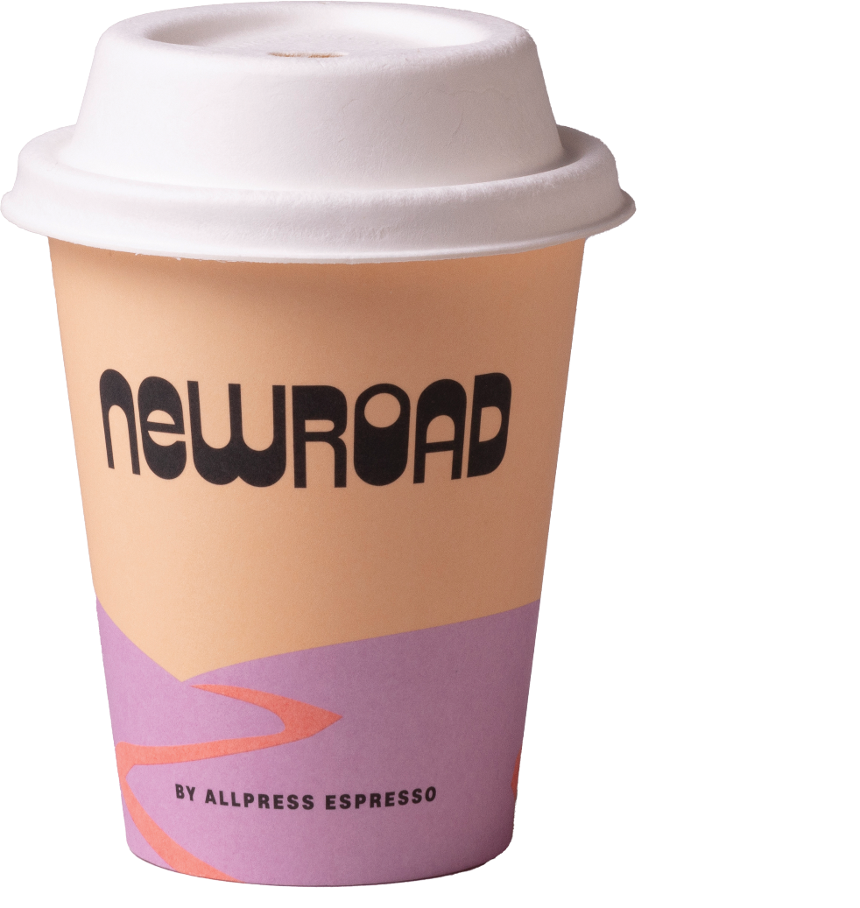

Donut, Cake or Slice
Chicken Schnitzel Wrap $12.00
Schnitzel, Lettuce and Sweet Chili
Mediterranean Turkish Roll $10.50
With Roast Vegetables, Sundried Tomatoes, Olives & Feta
Chicken Turkish Roll $12.00
With Chicken & Fresh Herb Mayo
Roasted Vege & Halloumi Salad $13.50
Add Grilled Chicken $4.00
with a Large Coffee
$11.00
House Made Sandwiches |  | $7.90
Pies & Sausage Rolls | From | $7.00
Assorted Bakery Items
As Displayed
From $6.00
All rolls , wraps and sandwiches are made fresh daily on site

Slide 5


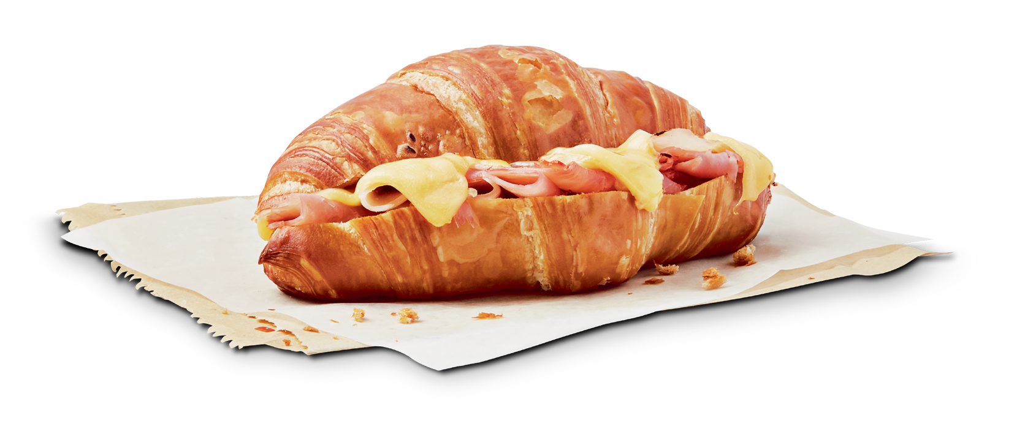
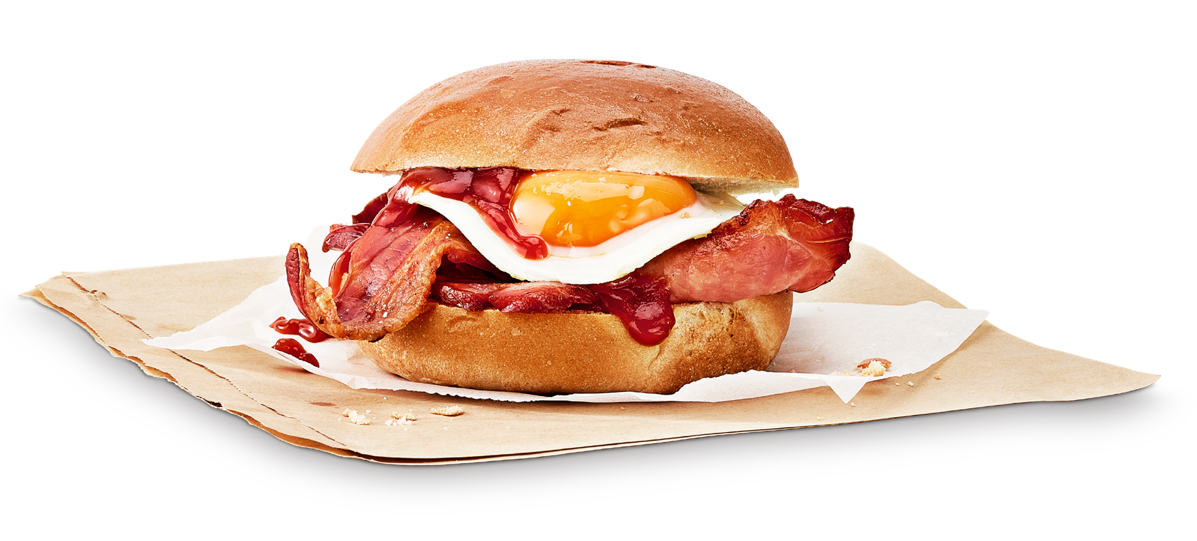
(Served till 11am)
$11.50
Bacon & Egg Roll
& Choice of:
Regular Coffee,
Hot Chocolate or Tea
$15.00
Bacon & Egg Roll* (GFO)
Vegetarian Breakfast Roll* (VEG) (GFO)
With Tomato Chutney, 2 x Fried Eggs, Hashbrown & Cheese
$11.50
Ham & Cheese Croissant Hash Brown (GFO)
$9.00
$2.50
*Available with a Gluten Free Bun for an additional $2.50
(GFO) - Gluten Free Option

